Slide 1
Several slides in this presentation contain animations which can only be viewed in Slide Show mode
Kindly press F5 followed by the Enter key to continue in
Slide Show mode

Slide 2
CAN Bus

Slide 3
What is CAN and what is a Bus?

Slide 4
What is CAN ?
CAN stands for
Controller Area Network i.e.
Microcontroller Area Network

Slide 5
What is a bus?
A channel of communication between two or more electronic devices
where
messages in the form of electrical waveforms can travel in both directions

Slide 6
What is a CAN Bus?
A channel of communication between two or more microcontrollers
Where
messages in the form of electrical
waveforms can travel in both direction
Which
obey a highly sophisticated set of rules called the
CAN Bus Protocol

Slide 7
Where can you find a CAN Bus System ???
Automotive
Farming
Aeroplanes
Medical equipment and devices
Passenger and Cargo Trains
Lifts and escalators
Factory automation
Industrial machine control
Maritime electronics
Non-industrial control and equipment

Slide 8
Why do we need a CAN Bus ???

Slide 9
Without a CAN Bus
(point to point communication)
Controller A
Controller E
Controller G
Controller C
Controller D
Controller B
Controller F

Slide 10
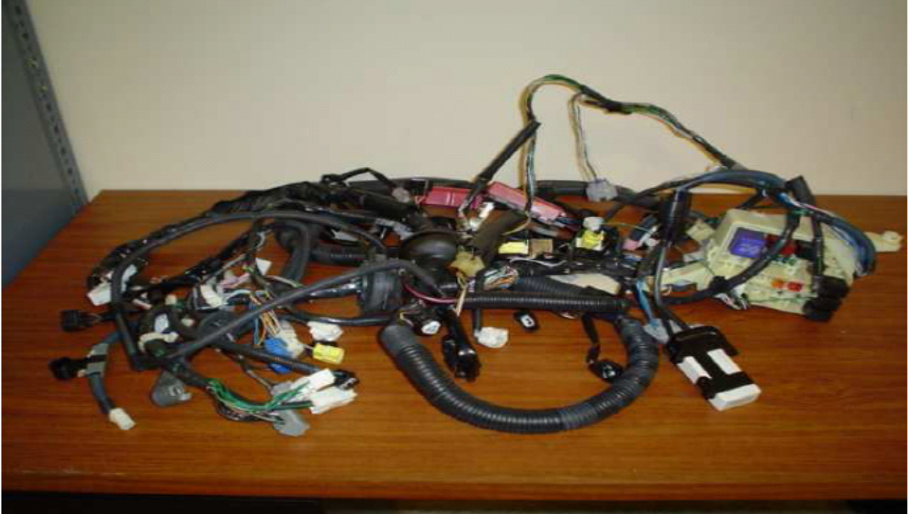
Wiring harnesses currently in use (complicated, messy & confusing)

Slide 11
With a CAN Bus
Controller A
The Bus
(serial)
Controller E
Controller G
Controller C
Controller D
`Controller B
Controller F

Slide 12
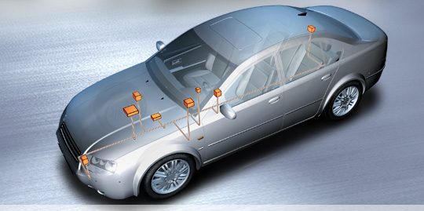
Example of a CAN Bus system with 8 nodes

Slide 13
A little History lesson
CAN was first developed by Robert Bosch GmbH, Germany in 1986 when they were requested to develop a communication system between three ECUs (electronic control units) in vehicles designed by Mercedes.
They found that point to point communications was no longer suitable in this situation. The need for a multi-master communication system became imperative.
The first CAN silicon was then fabricated in 1987 by Intel

Slide 14
Advantages of a CAN Bus
Organized and sophisticated compared
to current point to point communication
Reduction in weight and cost of wiring looms/harnesses
Can handle multiple controllers simultaneously
Works in Real Time
Can be used in various applications

Slide 15
A CAN Bus system works by sending and receiving messages
from
node X to node Y

Slide 16
What is a NODE?
A sensor or actuator connected to a microcontroller and any other device (for ex: ADC) that helps to turn this assembly into a fully functional stand-alone unit is called a
NODE

Slide 17
There are 2 types of Nodes
Transmitter
  A node originating a message is called a transmitter of that message
Receiver
  A node receiving a message that it is not transmitting itself is called a receiver of a message

Slide 18
Nodes send and receive messages by obeying a highly sophisticated protocol (set of rules) called the
CAN Bus protocol

Slide 19
How many CAN Bus protocols are there?
There are two CAN Bus protocols
CAN BUS 2.0 A
CAN BUS 2.0 B
CAN 2.0 A is used with smaller, less complicated systems
CAN 2.0 B is used with larger, more complicated systems

Slide 20
The heart & soul of the CAN Bus protocol deals with a
FRAME into which the
MESSAGE to be sent or received on the CAN Bus is encoded

Slide 21
There are only 2 types of Frames
A Frame that contains
a request for data
A Frame that contains
the requested data

Slide 22
The frame that contains a request for a particular data is called the
REMOTE TRANSMISSION REQUEST FRAME

Slide 23
The frame that contains the requested data is called the
DATA FRAME

Slide 24
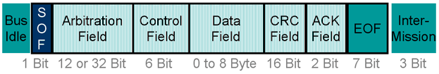
The DATA FRAME
1
2
3
4
5
6
7
The start of frame
The end of frame
The Data frame consists of 7 distinct parts

Slide 25
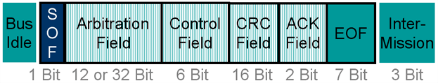
The RTR Frame
Remote Transmission Request
1
2
3
4
5
6
The start of frame
The end of frame
The Data frame consists of 6 distinct parts
Notice the absence of the DATA field

Slide 26
A Frame consists
of a large number of bits (0’s and 1’s)
The bits present in a frame are of two types
Dominant bit
&
Recessive bit

Slide 27
Dominant bit represents 0
&
Recessive bit represents 1
The Dominant bit has a higher priority than the Recessive bit

Slide 28
We shall now discuss each of the 7 parts that make up a FRAME starting with SOF – Start of Frame

Slide 29
SOF – Start of Frame
The SOF consists of a single bit
This is the MSB i.e. Most Significant bit present in the FRAME
This bit is dominant (0) always

Slide 30
Arbitration Field
The arbitration field is the
most important field for the programmer or system designer
It is also called as the Identifier field as the INDENTITY of the entire frame traveling on the bus is figured out by decoding this field

Slide 31
What does ARBITRATION mean?
&
What does IDENTITY mean?

Slide 32
What is Arbitration?
The settling of a dispute between two or more individuals by a third person chosen by them
In CAN, this translates into the settling of a collision between two or more frames sent onto the bus simultaneously (by two or more nodes) with the help of the CAN protocol (third person)

Slide 33
What is an IDENTITY?
The unique, individual characteristics by which a person or thing is recognized or known such as
Genes
PAN card number
Telephone number

Slide 34
Arbitration & Identity
The bits present in the ARBITRATION field can be arranged intelligently
by
the programmer so that each FRAME is easily distinguished by the unique sequence of bits present in this field
This unique sequence of bits constitute an IDENTITY

Slide 35
Thus an IDENTITY facilitates the ARBITRATION process with it’s unique pattern of 0’s and 1’s
which
We shall see in the coming slides a little further down in this presentation

Slide 36
Arbitration field
- Contd
CAN Bus 2.0 A, has an arbitration
field that is 11 bits long which can
have 2048 different combinations
This means - that with a 11 bit long identifier there can be 2048 unique frames
These 2048 unique frames can then be sent onto the bus and each of these frames can then be easily identified by all the nodes present on the bus

Slide 37
How do we get 2048 unique combinations from 11 bits?
Since we follow the Binary format consisting of 0 and 1,
11 bits can give us 2048 combinations as follows
2¹¹ = 2*2*2*2*2*2*2*2*2*2*2
⁼ ²⁰⁴⁸

Slide 38
Arbitration field
- Contd
CAN Bus 2.0 B, has an arbitration
field that is 29 bits long which can have over 5 million different combinations
This means with a 29 bit long identifier there can be over 5 million unique frames
These 5 million unique frames can then be sent onto the bus and each of these frames can then be easily identified by all the nodes present on the bus

Slide 39
Thus, the bits present in an arbitration field are a carefully selected combination of dominant (0) and recessive (1) bits that have to be decided by the programmer
which
decides the priority level of the different FRAMES being sent onto the bus
and
also acts as a unique identifier which helps a node identify any FRAME present on the Bus

Slide 40
Our discussion from this point onwards shall consist only of CAN Bus 2.0 A, as the 2048 unique identifiers it provides to send and receive 2048 unique frames is more than sufficient for most applications present in the world today

Slide 41
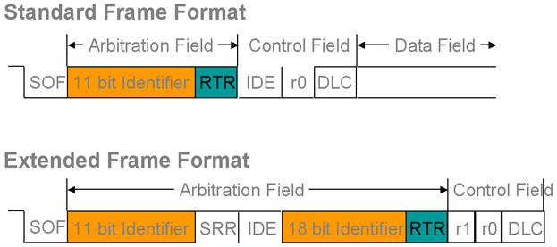
The last bit present in the
arbitration field is an RTR bit
In the DATA frame the RTR bit
is always dominant (0)
In the Remote frame the RTR bit
is always recessive (1)
RTR – Remote Transmission Request

Slide 42
Control Field
It consists of 6 bits
The first bit is an IDE bit i.e.
Identifier Extension bit
This bit is used if CAN Bus 2.0 B with the extended identifier format consisting of 29 bits is desired to be used
The second bit r0 has been reserved for future use and its status is of no use to us

Slide 43
Control field - contd
The last 4 bits represent the
number of bytes that are present
in the next field i.e. the Data field
There can be a minimum of 0 bytes to a maximum of 8 bytes that can be sent as data in a frame
Data Length Code

Slide 44
Control Field – contd
Data Length code in Binary
Byte | Code in Binary
0 | 0000
1 | 0001
2 | 0010
3 | 0011
4 | 0100
5 | 0101
6 | 0110
7 | 0111
8 | 1000

Slide 45
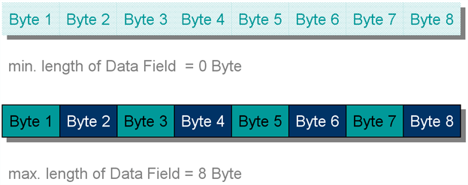
Data Field
Maximum length = 8 bytes

Slide 46
CRC Field
Cyclic Redundancy Check
This field is used to calculate the
bit errors present within a CAN frame
The CAN controller does this operation automatically
There are a total of 16 bits present in this field
Of this, the value of the bits in the first 15 fields are automatically calculated
The last bit is called the CRC Delimiter and is always recessive (1)

Slide 47
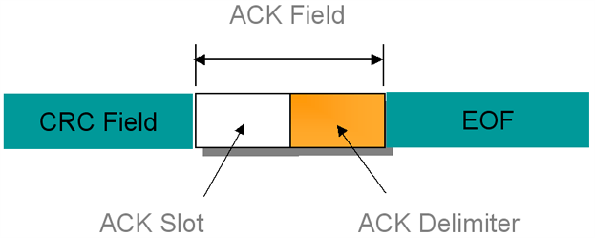
Acknowledgement Field
The acknowledgement
field is 2 bits long
It consists of the ACK slot and the ACK Delimiter

Slide 48
Acknowledgement Field
The ACK Delimiter as is the case with all Delimiter’s found in a frame is always recessive (1)
The node that transmits a frame, transmits the ACK slot as recessive (1)
The node that receives a frame successfully, reports this to the transmitter by sending a dominant bit in the ACK slot (0)

Slide 49
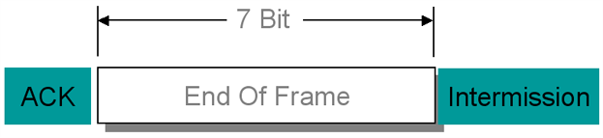
End of Frame
The EOF consists of 7 bits
All these bits are recessive (1)

Slide 50
Intermission
The Intermission field consists of
3 bits
All these bits are recessive (1), ALWAYS
An intermission field is present in between
consecutive DATA frames and RTR frames

Slide 51
Bus Idle
When the bus is idle, it is in a recessive state
Thus there will be an infinite series of recessive (1) bits that will be found on the bus in this state

Slide 52
NEXT TOPIC

Slide 53
Broadcasting a frame onto the Bus
&
Receiving a frame from the Bus

Slide 54
To broadcast a Frame onto the Bus we need a node that sends a Frame onto the Bus i.e. a Transmitter
& we need a node that receives a Frame from the Bus i.e. a Receiver

Slide 55
Transmitter
(Node)
The transmitter consists
of 3 different blocks
  Local Intelligence
  Frame
  Filter
Local
Intelligence
Receiver
Frame
Filter
(Node)
The receiver consists of 3
different blocks
  Local Intelligence
  Frame
  Filter
Local
Intelligence
Frame
Filter

Slide 56
What job does the Local Intelligence block and Filter block do ?
(We have already covered Frames in depth)

Slide 57
Local Intelligence consists of the sensor or actuator and the microcontroller functioning intelligently
by
sending FRAMES onto the bus
or
receiving FRAMES from the bus
as and when
instructed to do so

Slide 58
Filter
A Filter can be compared to a Security Guard with a big moustache and an even bigger pot belly standing at the entrance of a large gate
Messages carried by a person can enter this gate ONLY if the security guard is able to verify the identity of the person by checking his ID card

Slide 59
Filter - contd
Similarly in a CAN Bus system a FRAME is allowed to go through the FILTER onto the local intelligence
ONLY IF
the identity of the FRAME present in the Identifier field (also known as the arbitration field) matches the uniquely coded bits present in the FILTER

Slide 60
Broadcasting & Receiving a Frame
Node A
Node B
Node C
Node D
Local
Intelligence
Local
Intelligence
Local
Intelligence
Local
Intelligence
The Frame is now allowed to enter
Node D
Thus the Frame sent by node B
Properly finds it way to node D
Transmitting
a Frame onto
the bus
The bits in the identifier field of
the frame match the bits present
in the FILTER situated in Node D
Frame
Filter
Frame
Filter
Frame
Filter
Frame
Filter
BUS
Each Filter is now checking the IDENTIFIER bits of the Frame
and is deciding whether to let the frame in or keep it out

Slide 61
FRAME Arbitration

Slide 62
For FRAME Arbitration
Let us assume that three nodes
broadcast their respective frames
onto the bus simultaneously
Of these 3 frames, finally only 1 frame with the highest priority can travel across the bus
The remaining 2 frames will have to wait for the highest priority frame to reach its
destination
After it has reached its destination, the remaining 2 nodes can then begin transmitting their frames on the bus

Slide 63
These 3 nodes will have 3 unique identifiers respectively
These unique identifiers will be present in the arbitration field of the FRAME
In a previous slide it was mentioned that the Dominant bit (0) has a higher priority than the recessive bit (1)
This bit priority predetermined by the CAN Protocol will decide which frame wins the arbitration battle being fought on the bus

Slide 64
Let us make up 3 unique identifiers for each node
Node A Identifier – 11001110001
Node B Identifier – 11001011011
Node C Identifier – 11001011001
(Notice that they are 11 bits long)

Slide 65
FRAME Arbitration
Arbitration field made up of identifiers
SOF
10
9
8
7
6
5
4
3
2
1
0
RTR
011001110001
Node A
Listen Only – Node A Loses Arbitration
011001011011
Node B
Listen Only – Node B
Loses Arbitration
011001011001
Node C
On the Bus
Bus
Bus

Slide 66
Node A loses the arbitration battle to Node B & Node C at the 5th bit present in the arbitration field
as
the 5th bit present in Node A is recessive (1)
whereas
the 5th bit present in Node B & Node C is dominant (0)
As the dominant bit (0) has a higher priority than the recessive bit (1), Node A is forced into
LISTEN ONLY mode
and
Node B & Node C continue the arbitration battle on the bus which is finally won by Node C

Slide 67
So far we have shown how a message encoded in a frame is transmitted over the Bus and how arbitration takes place over the bus

Slide 68
Have we missed out on something
while transmitting a message
across the bus
???

Slide 69
Any Guesses
???

Slide 70
We forgot
THE CLOCK
Oh My God !!!!!!

Slide 71
CAN Synchronization
&
Bit Timing

Slide 72
Several different nodes on a bus have their own individual internal clocks running at a frequency that MUST be common across the bus
Let us say that our system has 5 nodes
Each of these 5 nodes has a clock with a frequency of 16 Mhz

Slide 73
Even though each node has a clock that operates at the same 16 Mhz frequency, it is practically impossible that these 5 clocks run in perfect synchronicity with each other
There is bound to be a certain tolerance limit in which the clock operates, for example from 15.99 Mhz to 16.01 Mhz

Slide 74
This deviation of +/- 0.2 Mhz is caused due to practical reasons such as variations in
  temperature
  material properties of the quartz crystal
  manufacturing defects

Slide 75
To take care of these deviations in operating frequencies and to ensure that all the nodes on the bus are in perfect synchronicity with each other
we move on to the next topic
i.e.
Bit Timing

Slide 76
What is a BIT
&
What is BIT TIME???

Slide 77
Bit 1
Bit Time Duration
also known as
BIT TIME
Bit 0

Slide 78
Bit Time is defined as the time taken by each bit to represent itself
Higher frequencies result in smaller bit time
Lower frequencies result in longer bit time

Slide 79
A Bit Time is divided into 4
non-overlapping time segments

Slide 80
4 non-overlapping time
segments present in a BIT
Bit Time duration
Sample point
1
2
3
4
Propagation
segment
Synchronization
segment
Phase
Segment 1
Phase
Segment 2

Slide 81
Each time segment is further divided Into a number of smaller units called Time Quanta
A Time Quanta is the smallest unit of time present in a BIT

Slide 82
Time Quantas (TQ)
present in a BIT
Sample point
1
2
3
4
TQ
TQ
TQ
TQ
TQ
TQ
TQ
TQ
TQ
TQ
TQ
TQ
Synchronization
segment
Propagation
segment
Phase
Segment 1
Phase
Segment 2

Slide 83
The total number of Time Quanta that are present in a BIT
must
be greater than 8 Time Quanta
and
less than or equal to 25 Time Quanta

Slide 84
Synchronization Segment
This is the first non-overlapping time segment present in a bit
It’s duration is 1 Time Quanta, ALWAYS
It is responsible for synchronizing the various CAN nodes on the bus

Slide 85
Propagation Segment
This is the second non-overlapping time segment present in a bit
It’s duration is programmable to be between 1 to 8 Time Quanta in length
It is responsible for compensating the physical delay times on the nodes and the bus
The physical delay (obstructions in electron flow) is caused by the CAN bus cable, transmitting microcontroller and receiving microcontroller

Slide 86
Phase Segment 1
This is the third non-overlapping time segment present in a bit
It’s duration is programmable to be between 1 to 8 Time Quanta in length
It is responsible for compensating phase errors (mismatches in timing) with the help of an additional component called SJW or Synchronization Jump Width

Slide 87
Phase Segment 2
This is the fourth and last of the non-overlapping time segments present in a bit
It’s duration is programmable to be between 1 to 8 Time Quanta in length
It is responsible for compensating phase errors (mismatches in timing) with the help of an additional component called SJW or Synchronization Jump Width

Slide 88
Synchronization Jump
Width - SJW
The SJW acts like a washer used in
mechanical systems
Washers are added or removed from components in a mechanical system to make components fit into each other perfectly
SJW is a software washer
It is implanted into a BIT in such a way that the BIT TIME can compensate for the various shifts in phase (mismatched timing) while receiving a frame from another node
SJW can consist of a minimum of 1 TQ to a maximum of 4 TQ

Slide 89
Synchronization Jump
Width - SJW
Bit time = x
Synchronization
segment
Propagation
segment
Phase
Segment 1
Phase
Segment 2
Notice the increase in BIT TIME with the SJW added to it to compensate for mismatches in timing
Bit time = x + SJW
SJW
Synchronization
segment
Propagation
segment
Phase
Segment 1
Phase
Segment 2

Slide 90
Sample Point
It’s exact location is in-between the end of Phase segment 1 and the beginning of Phase segment 2
This is the point of time at which the BIT is read and interpreted
At this point we know whether the bit is dominant (0) or recessive (1)

Slide 91
What Next ???

Slide 92
Bit Timing on its own does 95% of the work required to synchronize the frames sent by the various nodes present in a bus
But 95% is not good enough
Synchronization between frames sent by the various nodes must reach as close to the 100% mark as possible for proper transmission and reception

Slide 93
This is done with the help of
Bit Stuffing

Slide 94
What is Bit Stuffing ???
The CAN Protocol intelligently inserts (stuffs) a bit (s) of opposite polarity into a FRAME,
If
a continuous series of bits of the same polarity exceed 5 in number

Slide 95
Bit Stuffing
For example, if a frame consists of
8 consecutive dominant (0) bits, the
CAN protocol will force the transmitter
to STUFF a recessive (1) bit after the 5th
consecutive dominant bit automatically
0
9
10
11
13
Bit sequence to
be transmitted
1
2
3
4
5
6
7
8
12
0
9
10
11
Transmitter
Stuffed Bit
sequence
S
1
2
3
4
5
6
7
8
12
Receiver
0
9
10
11
13
De-stuffed
Bit sequence
1
2
3
4
5
6
7
8
12

Slide 96
Bit Stuffing
Similarly, if a frame consists of 12
consecutive recessive bits, the CAN
protocol will force the transmitter to STUFF
a dominant (0) bit after every 5th consecutive recessive (1) bit automatically
1
2
3
4
5
6
7
8
9
10
11
12
14
16
Bit sequence to
be transmitted
0
13
15
Transmitter
1
2
3
4
5
6
7
8
9
10
11
12
14
16
Stuffed Bit
sequence
S
S
0
13
15
Receiver
1
2
3
4
5
6
7
8
9
10
11
12
14
16
De-stuffed
Bit sequence
0
13
15

Slide 97
The Node transmitting a FRAME will automatically stuff bits if required
The Node receiving the FRAME will automatically de-stuff the bits thereby returning the FRAME into it’s original form

Slide 98
Why is Bit Stuffing required ???

Slide 99
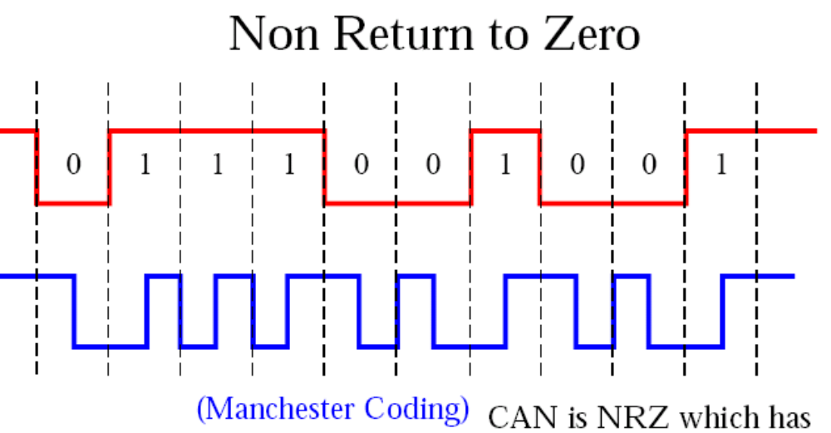
Because CAN follows NZR
i.e. Non Return to Zero coding
as against Manchester coding

Slide 100
Understood
????
Not Quite, huh
??????

Slide 101
Remember, we said that a BIT is made up of Time Quanta and each BIT should have a minimum of 8 TQ to a maximum of 24 TQ
We also know that by manipulating TQ’s we can negate the phase shifts or mismatches in Timing of FRAMES received from different nodes
All these things mentioned above help to achieve synchronicity between nodes because of which one can transmit and receive frames successfully

Slide 102
For all this matching & synchronizing business to take place successfully,
there is one small requirement without which nothing will work
What is this small requirement
???

Slide 103
AN “EDGE”

Slide 104
Without an EDGE, there is no reference point and without a reference point there is no way synchronization can take place
EDGE

Slide 105
So, if a FRAME has a large number of successive bits that are either dominant or recessive, there is a long gap before an edge appears
Successive recessive bits (1)
Long gaps in a frame
Successive dominant (0) bits

Slide 106
These long gaps throw the synchronization mechanism into complete confusion
In order to avoid this, an EDGE is introduced after regular intervals
In CAN an EDGE is introduced, if 5 successive bits of the same polarity are present in a FRAME by inserting
a BIT
with opposite polarity (BIT STUFFING), to facilitate the smooth functioning of the synchronization process

Slide 107
So now we know how FRAMES are sent and received on the CAN Bus synchronously
without
sending clock pulses simultaneously with the message as is done with I2C and SPI protocol
but
by intelligently manipulating the width of each bit (BIT TIME) with the help of small packets of time called TIME QUANTA
and
with the help of BIT STUFFING

Slide 108
Error Handling

Slide 109
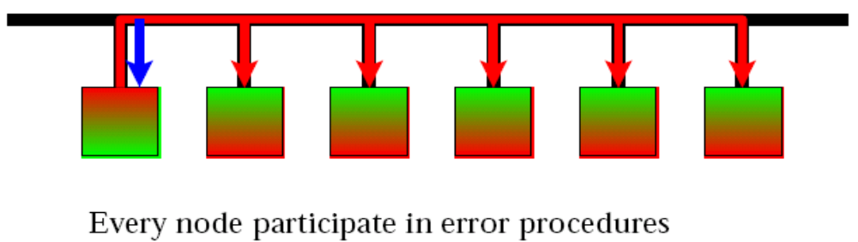
All nodes listen to any
message being transmitted
onto the bus
The transmitting node too listens to its own message while transmitting it onto the bus

Slide 110
Message Validation
The point of time at which a FRAME is taken to be valid is DIFFERENT for the transmitter and receiver of the message
Transmitter
  A FRAME is valid for a transmitter if there is no error till the end of the FRAME
Receiver
  A FRAME is valid for a receiver if there is no error till the last but one bit of the END OF FRAME

Slide 111
CAN Error Detection
Bit value check by Transmitter
Bit Stuff checking
Frame check
15 bit Redundancy check
Acknowledgement check

Slide 112
CAN Error Types
Bit error
Stuff error
Form error
CRC error
Acknowledgement error

Slide 113
Bit error
A Node that is transmitting a FRAME
listens to it’s own FRAME on the Bus
For example if a Node sends a sequence 01100110011 but on the bus it sees
01100100011, a bit error has occurred
An error frame is then sent onto the bus and the FRAME with the Bit error is ignored by all nodes

Slide 114
Stuff error
If a FRAME consists of the following bits 0110000000011100110
Then according to the bit stuffing rule there should a recessive bit (1) inserted after the 5th dominant (0) bit
So the FRAME should be transformed into 01100000100011100110 from
0110000000011100110
BIT STUFFING is done automatically by the
CAN Controller but for some reason if it does not happen, a STUFF ERROR occurs
An error frame is then sent onto the bus and the FRAME
with the STUFF ERROR is ignored by all nodes

Slide 115
Form error
The CRC Delimiter, ACK Delimiter and EOF
consist of recessive bits (1) ALWAYS
If a dominant bit (0) is detected in any of these, a FORM ERROR has taken place
An Error frame is then sent onto the bus and the FRAME with the FORM ERROR is ignored by all nodes
CRC Delimiter
EOF
ACK Delimiter

Slide 116
CRC error
Cyclic Redundancy Check
The CRC value is 15 bits long
This value is automatically calculated by the
transmitting and receiving nodes
If the CRC value of the FRAME calculated by the transmitting node is different from the CRC value of the FRAME calculated by the receiving node a CRC error has occurred
An error frame is then sent onto the bus and the FRAME with the CRC ERROR is ignored by all nodes

Slide 117
Acknowledgement error
A transmitting node keeps the value of the
ACK slot recessive (1)
A receiving node on successful reception
of a message changes the value of the ACK slot to
dominant (1)
If it fails to do this an acknowledgement error has occurred
An error frame is then sent onto the bus and the FRAME with the acknowledgement error is ignored by all nodes
ACK slot

Slide 118
ERROR FRAME

Slide 119
Error Frame
It is made up of two fields
  Error Flag Field
  Error delimiter Field
Error Flag
Error Delimiter
It consists of 6 to 12 bits
It consists of 8 bits

Slide 120
An error can occur during transmission
  A count is kept on these errors by a counter called TEC or Transmit Error Counter
An error can occur during reception
  A count is kept on these errors by a counter called REC or Receive Error Counter

Slide 121
The count value in TEC and REC must be maintained between a certain count limit that is predefined by the CAN Protocol
Depending upon the count value present in TEC and REC at each node, the Node can be in any of the 3 following states
  Active Error State
  Passive Error State
  Bus Off State

Slide 122
Active Error State
All the nodes on the bus
should be in Active Error State for normal transmission and reception of FRAMES
If any given node has less than 128 counts in it’s TEC and REC,
it is in Active Error State

Slide 123
Passive Error State
If any given node has greater
than 127 counts and less than 256 counts in it’s TEC and REC, it goes into Passive Error State
This is NOT a desirable state for any given NODE to be in
This state is caused due to more than the normal number of errors occurring while transmitting and receiving FRAMES

Slide 124
Nodes in Passive error state have a lower priority for transmitting frames than nodes in Active error state

Slide 125
Bus Off State
If any given node has more than 256 counts in it’s TEC,
it goes into in Bus Off State
In Bus Off State the given node is not allowed to Transmit or Receive any more FRAMES onto the Bus until the reason behind the excessive error generation has been identified and rectified

Slide 126
The 3 States of a Node
Initial error free
state of a node
Error
Active
If
TEC > 127
or
REC > 127
On RESET
Or
Error rectification
If
TEC < 128
or
REC < 128
Error
Passive
Bus
Off
If
TEC > 255

Slide 127
Coming back to the Error Frame
Error Flag
Error Delimiter
It consists of 6 to 12 bits
It consists of 8 bits
If an error occurs while a node is in
Error Active state then
  The error flag will consist of 6 consecutive dominant (0) bits
  The error delimiter will consist of 8 consecutive recessive (1) bits
6 dominant bits
8 recessive bits

Slide 128
Coming back to the Error Frame
Error Flag
Error Delimiter
It consists of 6 to 12 bits
It consists of 8 bits
If an error occurs while a node is in
Passive Active state then
  The error flag will consist of 6 consecutive recessive (0) bits
  The error delimiter will consist of 8 consecutive recessive (1) bits
6 recessive bits
8 recessive bits

Slide 129
Overload Frame
It is generated due to 2 conditions
  If the receiver is not yet ready to receive the next FRAME
  If a node detects a dominant bit during intermission
    An intermission consists of 3 bits
    ALL OF THEM ARE RECESSIVE (1) AT ALL TIMES
    As mentioned earlier, an Intermission frame is present between successive DATA and RTR frames

Slide 130
Overload Frame
An overload frame is similar to the error frame
It is made up of two fields
  Overload Flag Field
  Overload delimiter Field
Overload Flag
Overload Delimiter
It consists of 6 to 12 bits
It consists of 8 bits

Slide 131
Overload Frame
Overload Flag
Overload Delimiter
It consists of 6 to 12 bits
It consists of 8 bits
If an overload condition occurs then
  The overload flag will consist of 6 consecutive dominant (0) bits
  The overload delimiter will consist of 8 consecutive recessive (1) bits
6 dominant bits
8 recessive bits

Slide 132
The CAN Protocol generates
a maximum of 2 overload frames to delay the next DATA or RTR Frame
If the receiver is still not ready to receive the next frame,
an Error Frame is generated

Slide 133
Physical Layer of the CAN Bus

Slide 134
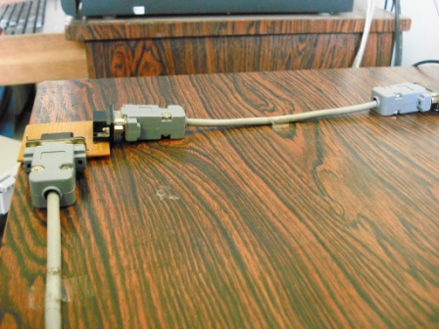
Physical layer

Slide 135
Physical Layer
It consists of a pair of twisted wires
that are shielded to reduce electromagnetic interference caused due to noise
One wire carries the CAN High signal
The other wire carries the CAN Low signal
The difference between these signals results in a dominant (0) or recessive bit (1)

Slide 136
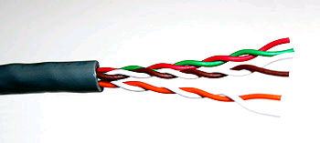
Shielded Twisted Pair Wires

Slide 137
Physical Layer
If the difference between the CAN High voltage and CAN Low voltage is less than 0.5 volts, the resulting bit is recessive (1)
If the difference between the CAN High and CAN Low voltage is greater than 0.9 volts and less than 3.5 volts, the resulting bit is dominant (0)

Slide 138
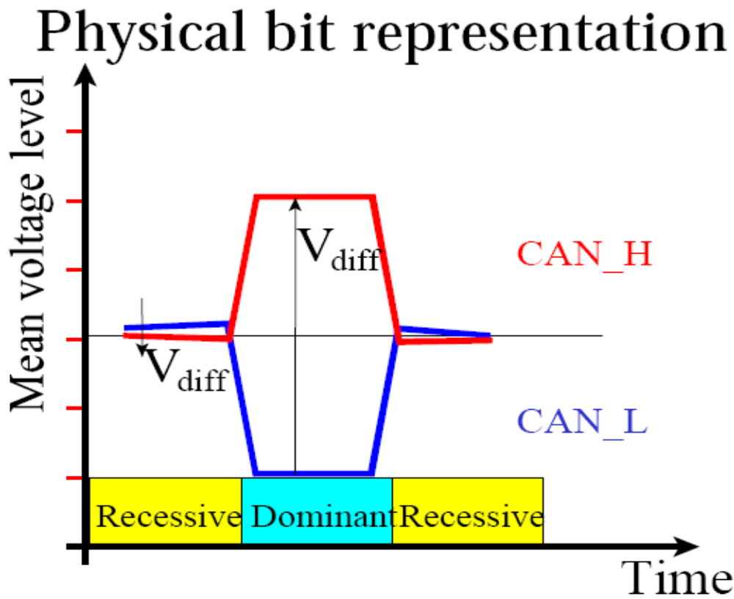
Differential voltages
CAN_H & CAN_L

Slide 139
CAN Bus Systems are present in harsh, noisy environments where mechanical and electrical disturbances induce unwanted voltages into the wires thereby corrupting the signal and making it unworthy
To prevent this from happening CAN uses the differential voltage system to figure out whether the BIT is Dominant (0) or Recessive (1)

Slide 140
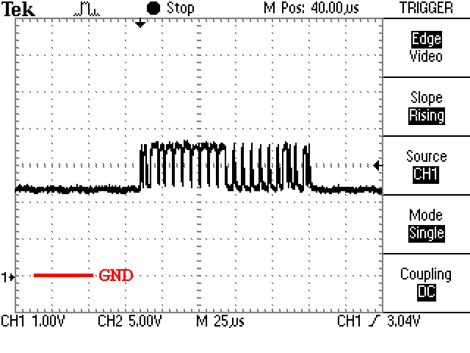
Electrical Waveform traveling through the Bus
BITS present in a FRAME
make the following waveform

Slide 141
THE END
HAVE A NICE DAY !!!

